Slide 1

DBBC3 Testing for APEX and Pico Veleta
Alan Roy
Sven Dornbusch
Gino Tuccari
Jan Wagner
Helge Rottmann
MPIfR / Istituto di Radioastronomia

Slide 2
Test Procedures
1 Timing Stability
Monitor 1 PPS output from firmware vs 1 PPS input to detect cycle slips
Clock synthesizer stability
Measure system phase stability end-to-end
Verify UTC timestamp in VDIF header
Check for delay jumps in recording
2 Analogue Input Components
IF conditioning module characteristics
Headroom
Mixer LO power requirement for downconversion
Total system bandpass characterization
Noise figure
3 Digital Transmission Integrity and Processing Correctness
Examine state counts of 8 bits from sampler
Examine state counts of 2 bits after thresholding
Examine 1 PPS rise time
Verify total power spectrum clean of artifacts
Verify 8 Gbps correct transmission
Verify OCT-D filter shape
Verify VDIF packet stream correctly formatted, no gaps, in time order, no stream mixing
4 Reliability
Cooling
Sustained recording test for infrequent errors.
5 Zero-Baseline Test
Check analogue correlation coefficient from noise source splitting
DBBC3 – DBBC3 Digital Correlation Coefficient for Partially Correlated Noise
DBBC3 – R2DBE Digital Correlation Coefficient for 100 % Correlated Noise
6 On-Sky Fringe Test
Kashima – Onsala Test

Slide 3
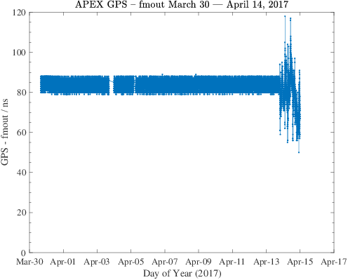
Timing Stability
Monitor 1 PPS Output from Firmware vs 1 PPS Input to Detect Cycle Slips
11 days
● GPS-FMOUT for APEX DBBC3 during EHT 2017 run
● No cycle slips over 11 days; a 10 MHz slip would make 100 ns step.
● The counter was recabled to the R2DBE FMOUT on April 13

Slide 4
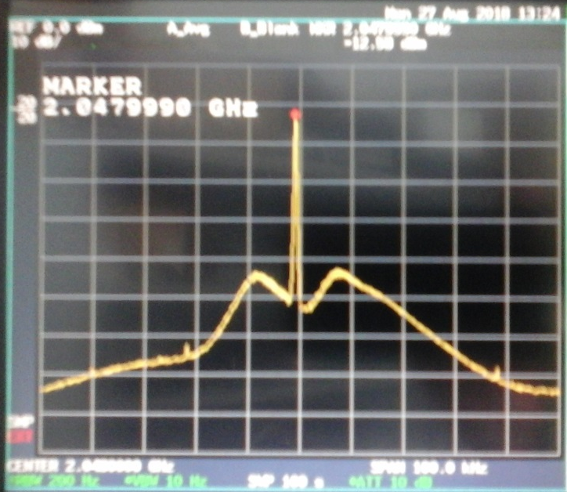
Timing Stability: Sampler Clock on Spectrum Analyzer
50 dB
50 kHz
● SSB phase noise integrated 1 kHz to 100 kHz offset → 3.9° RMS random phase jitter
● Minimal loss but anywal seems a bit high since doesn’t include noise < 1 kHz offset
● Next use FFT analyzer to examine closer offsets from carrier

Slide 5
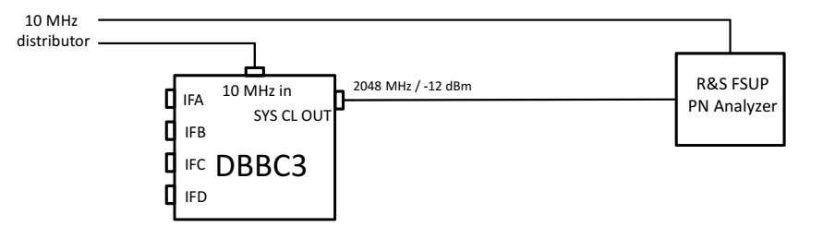
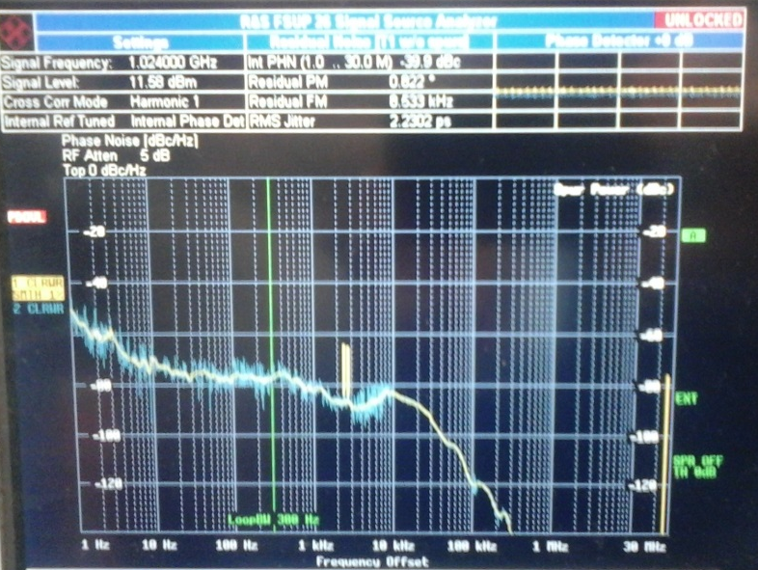
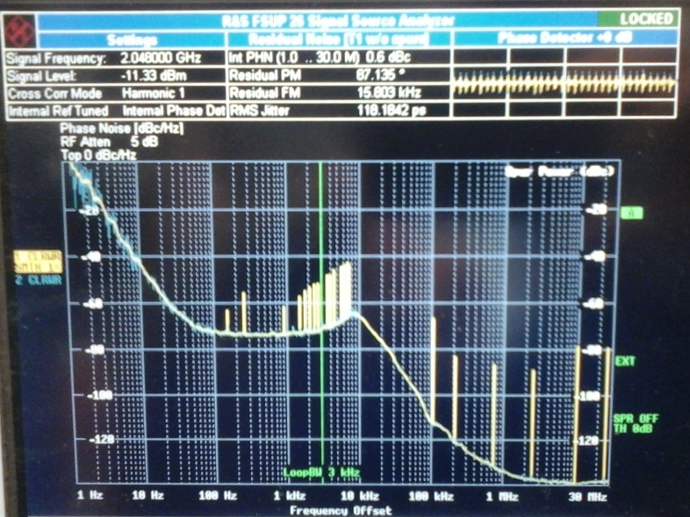
Timing Stability: Sampler Clock on FFT Analyzer
Excess close-in PN
Clock set to 1024 MHz
Clock set to 2048 MHz (EHT setting)
0 dBc
-140 dBc
1 Hz
30 MHz
1 Hz
30 MHz
0.8° RMS random phase jitter
87° RMS random phase jitter(!!!)

Slide 6
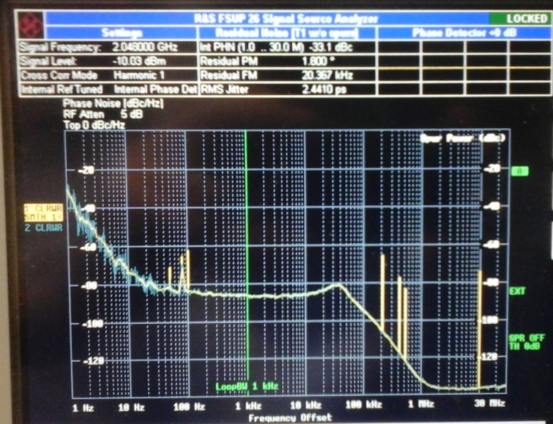
Timing Stability: Sampler Clock on FFT Analyzer
Valon
Valon comparison set to 2048 MHz
Internal clock set to 2048 MHz
0 dBc
-140 dBc
1 Hz
30 MHz
1 Hz
30 MHz
1.8° RMS random phase jitter
87° RMS random phase jitter(!!!)

Slide 7
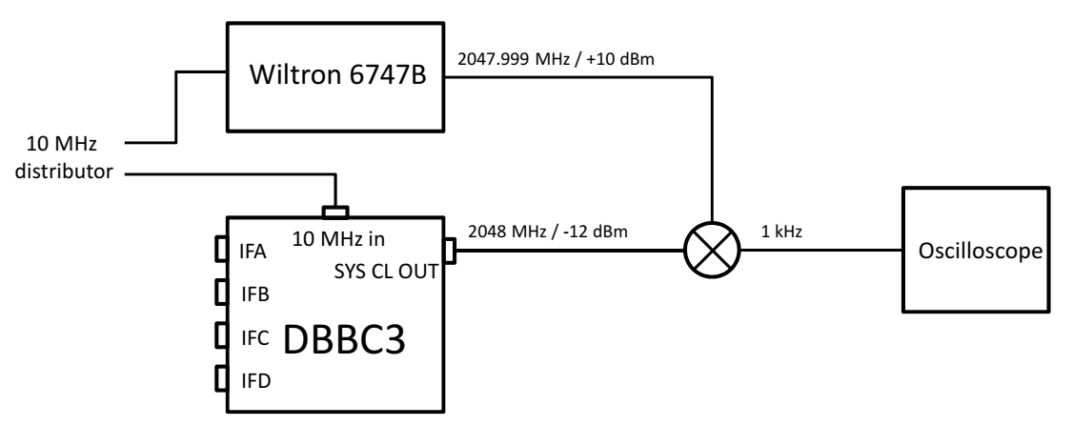
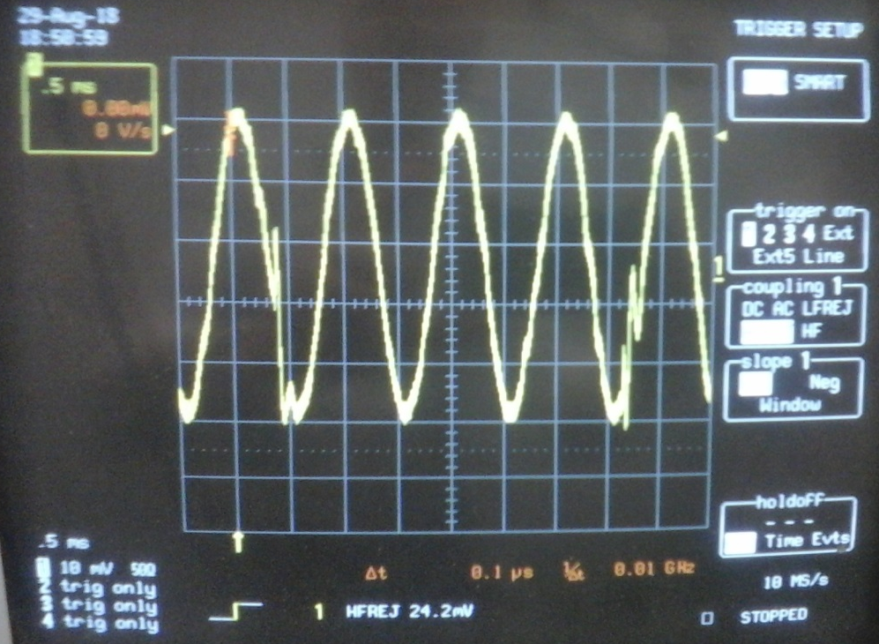
Timing Stability: Sampler Clock on Oscilloscope
Internal clock set to 2048 MHz
● Solid stable phase
● Much less than 87° RMS
● Occasional wobbles but returns to correct phase
● Valon also wobbles in same way → wobble in Wiltron?
● Looks like FFT analyzer issue
1 ms

Slide 8
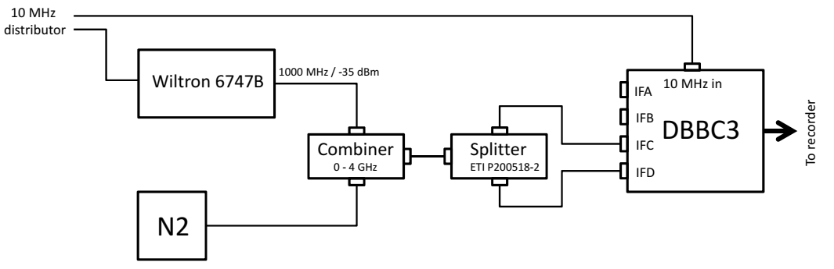
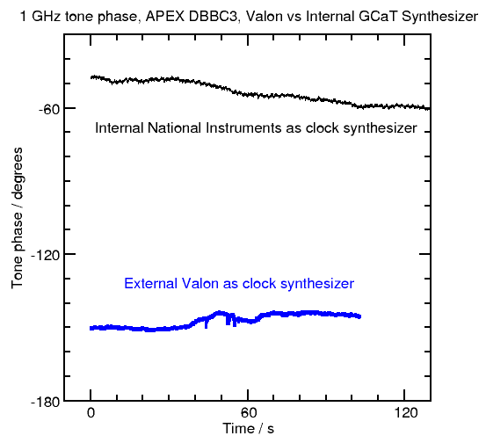
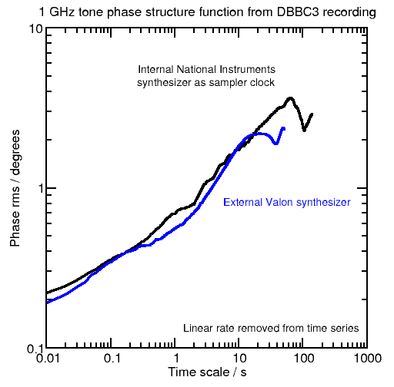
Timing Stability: Phase Stability End-to-End

Slide 9
Timing Stability: Timestamp Correctness
vdiftimecheckUDP:
● VDIF header timestamps are correctly decoded
● Agreement with system time on the Mark 6 from NTP
● Differences typically milliseconds.
Check for Delay Jumps in Recording:
Long history of recordings over many experiments → no delay jumps

Slide 10
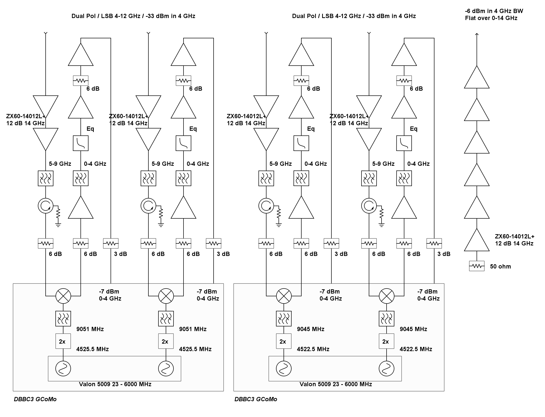
Analogue Conditioning

Slide 11
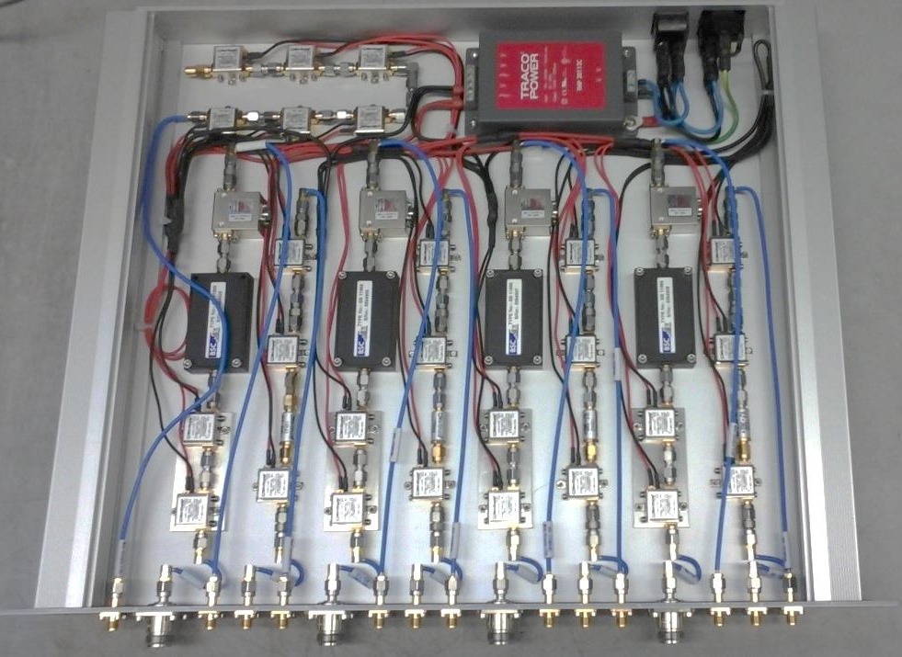
Analogue Conditioning:
Analogue Conditioning Module for DBBC3 at APEX:
4-12 GHz IF in from receiver
Gain, 5-9 GHz BPF, impedance matching, downconversion (in GCoMo)
0-4 GHz gain, baseband out to DBBC3 GCoMo

Slide 12
Analogue Conditioning: GCoMo
0-4 GHz /
(20±9) dBm
baseband in
0-4 GHz / +1 dBm
to sampler
0-4 GHz baseband in
Gain, digital attenuator, 4 GHz anti-aliasing LPF, TP detection
Tunable LO (Valon) for downconversion
4-12 GHz IF in

Slide 13
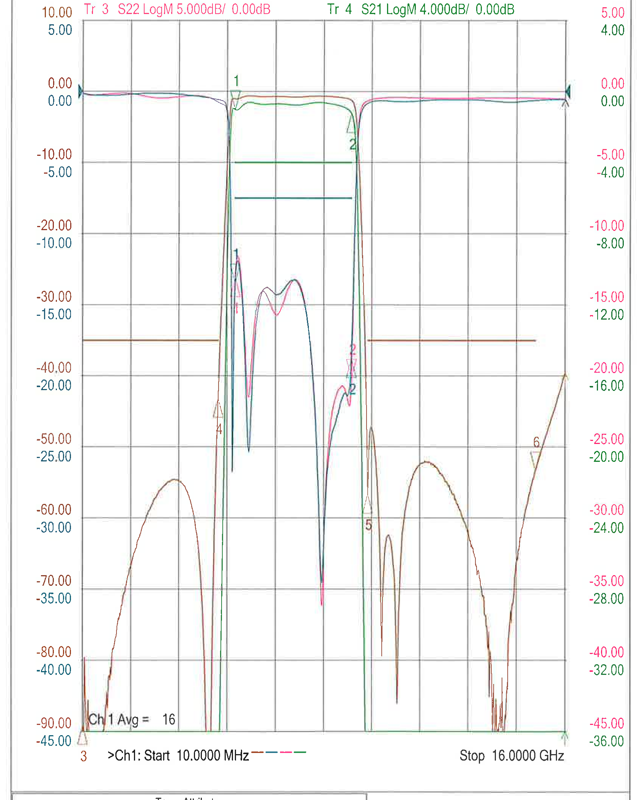
Analogue Conditioning: 5-9 GHz BP filter (BSC)
4952 MHz / 2 dB down
9048 MHz / 2 dB down
0 dB
Flank: 140 dB/GHz
Flank: 106 dB/GHz
-45 / -90 dB
10 MHz
16 GHz

Slide 14
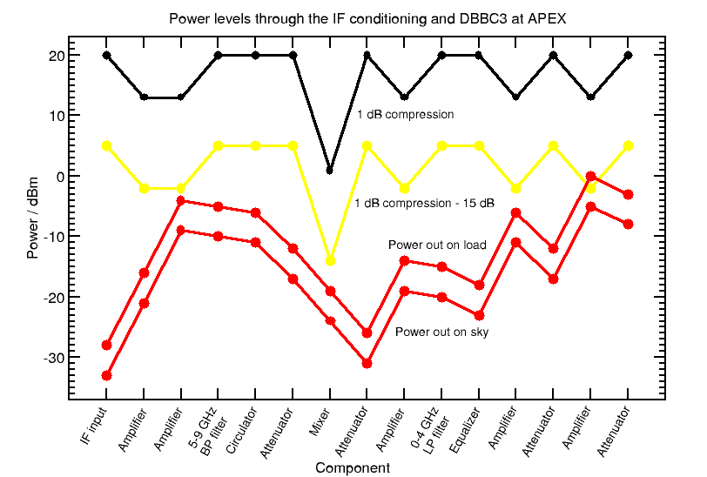
Analogue Conditioning: Headroom Design
Design rule: Stay ≥ 15 dB below 1 dB compression point

Slide 15
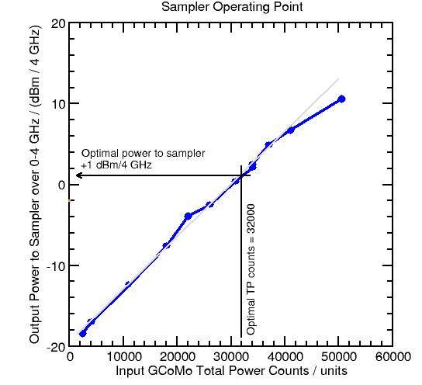
Analogue Conditioning: Linearity and Operating Point

Slide 16
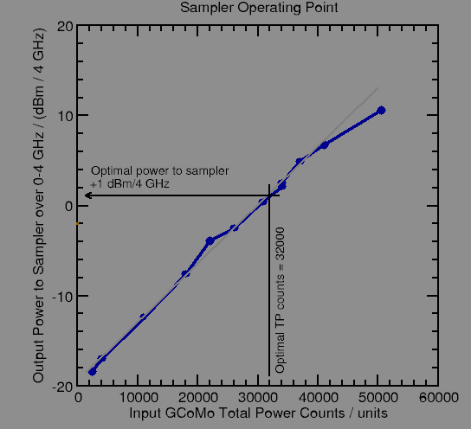
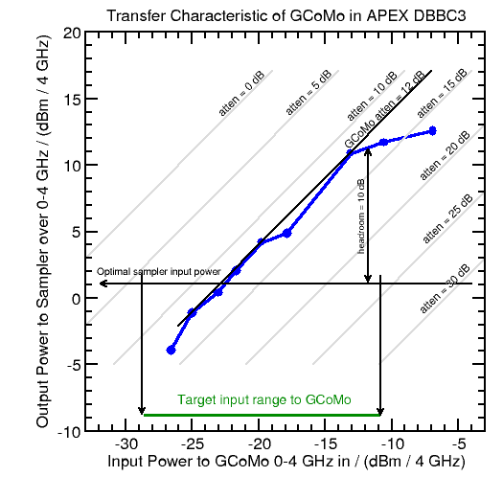
Analogue Conditioning: Linearity and Operating Point

Slide 17
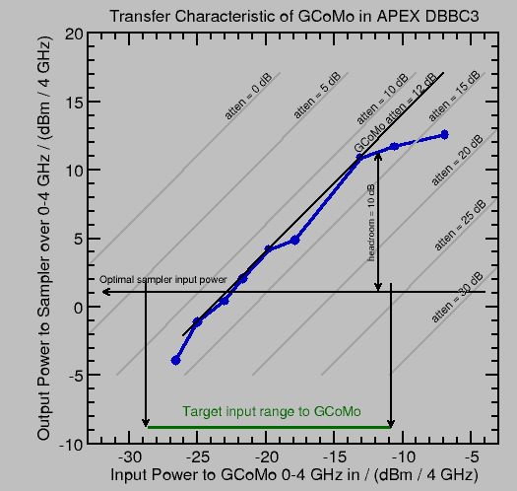
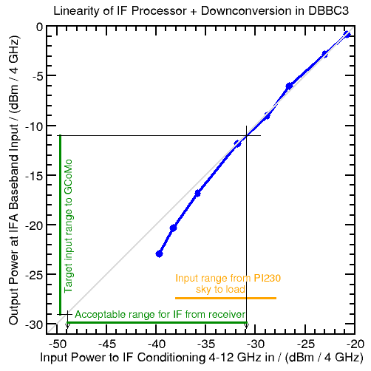
Analogue Conditioning: Linearity and Operating Point

Slide 18
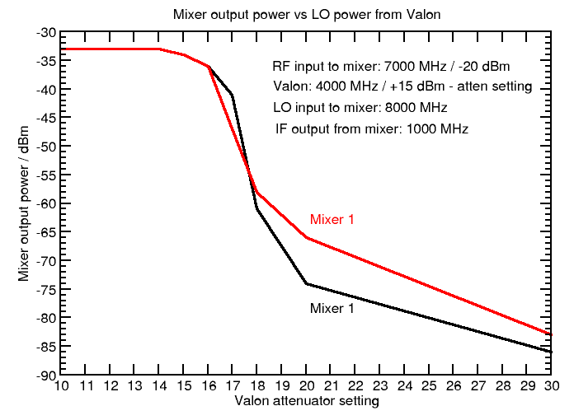
Analogue Conditioning: Mixer LO Power Requirement
Operating point for LO power, mixer in saturation

Slide 19
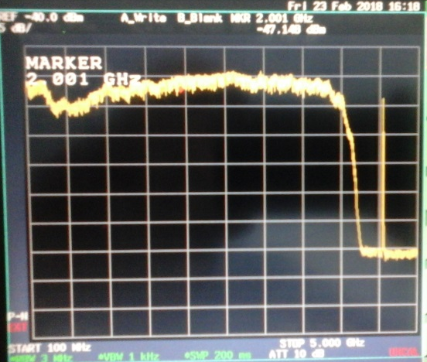
Analogue Conditioning: Analogue Passband Shape
Passband at 0-4 GHz GCoMo Input
after downconversion from 5-9 GHz
IF source: nearly flat noise 0-14 GHz
LO fundamental at 4524 MHz
before doubler breaking
through mixer to IF
Gets removed by 0-4 GHz
anti-aliasing LPF before
sampler
Noise source
structure
5 dB/div
100 MHz
5000 MHz
10 dB down at 4090 MHz

Slide 20
Digital Data Integrity
8 bit state counts: All lines active, none tied high or low
2 bit state counts: Values after thresholding typically 16 % 34 % 34 % 16 %
Total power spectrum: Clean of artifacts
Analysis of recorded VDIF: No missing packets,
No out of order packets,
ADC thread re-interleaving done correctly,
Data validity is high on DiFX/fourfit

Slide 21
Reliability: Sustained recording test
● Many weeks of run time on the APEX DBBC3:
No firmware instability (eg no loss of sync, no delay jumps, no hangs).
Ten DBBC3’s in field operations: not much support requested from HAT-Lab
● Many hours of analysis of the output 10 GE data streams on protocol analyzer:
no errors, no packets out of order.
● 2 % frame loss on Mark 6 recordings fixed with Mark 6 tuning
● Cooling: FPGA die temperatures 49 °C to 57 °C for ambient temp 23 °C to 29 °C.
Max spec 120 °C. Comfortably low.

Slide 22
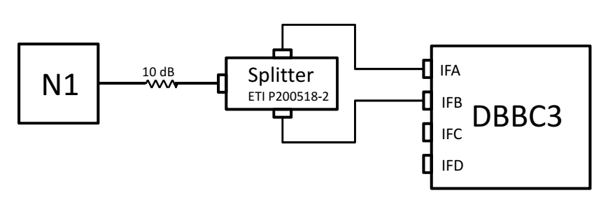
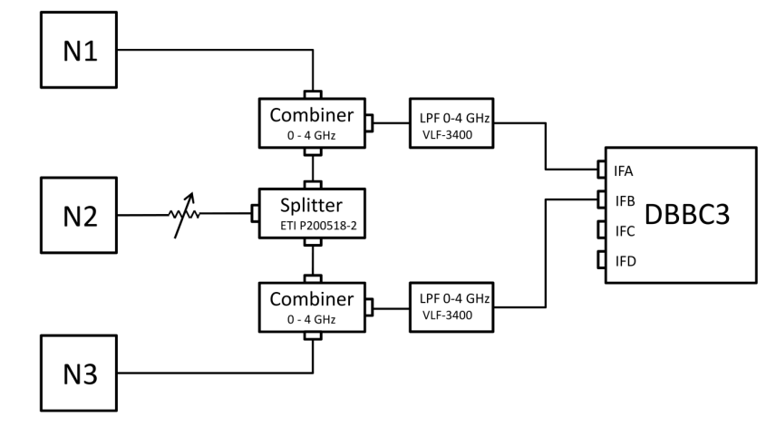
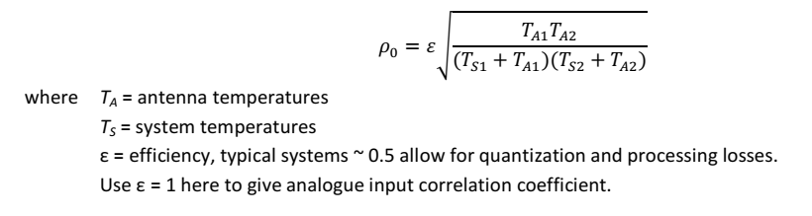
Zero Baseline Test: DBBC3-DBBC3 Setup
For 100 % correlated noise:
For partially correlated noise:

Slide 23
Zero Baseline Test: zerocorr analysis example for ρ₀ = 0.336
Cross- and Auto-Correlation Spectra
Cross-Correlation Amplitude and Phase
Cross-Correlation Amplitude Normalized by Autos
Fringe Peak in Delay Space
ρ_{digital} = 0.282

Slide 24
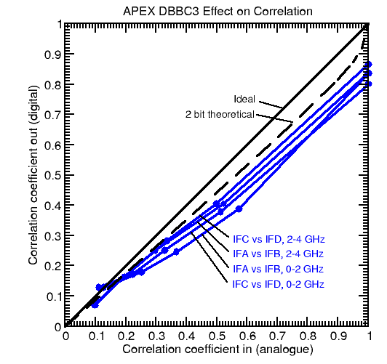
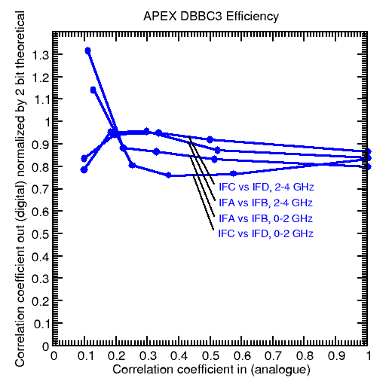
Zero Baseline Test: zerocorr analysis example for ρ₀ = 0.336
Efficiency of each DBBC IF: 87 % to 94 %

Slide 25
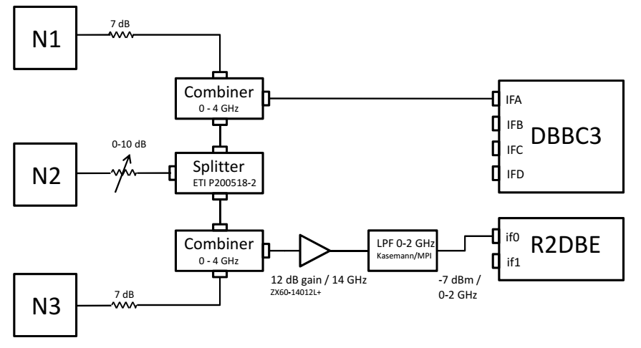
Zero Baseline Test: R2DBE vs DBBC3 Setup
For 100 % correlated noise:
For partially correlated noise:

Slide 26
Zero Baseline Test: R2DBE – DBBC3 Cross-Corr Bandpass

Slide 27
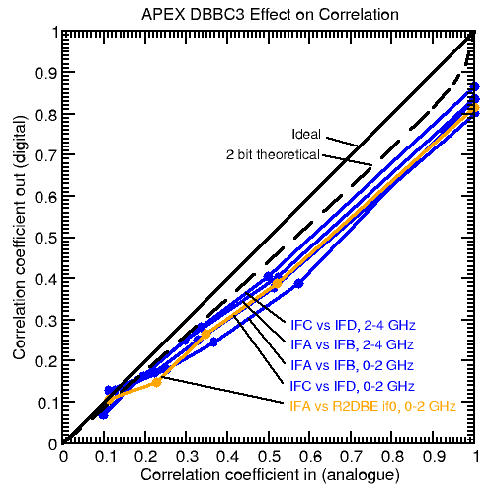
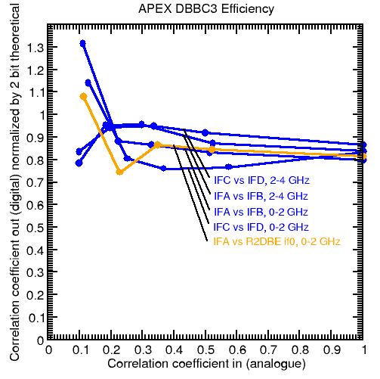
Zero Baseline Test: zerocorr analysis example for ρ₀ = 0.336
Efficiency of each backend: 90 % to 93 %

Slide 28
On-Sky Fringe Test: Kashima - Onsala
People: Mamoru Sekido NICT, Kashima Space Technology Centre, Japan
Kazuhiro Takefuji NICT, Kashima Space Technology Centre, Japan
Karl-Åke Johansson Onsala Space Observatory, Sweden
Simon Casey Onsala Space Observatory, Sweden
Rüdiger Haas Onsala Space Observatory, Sweden
Gino Tuccari MPIfR
Sven Dornbusch MPIfR
Date: 27.03.2018, 19 h observing track
Stations: Kashima 34 m
Onsala 13.2 m twin telescope (ONSA 13NE)
Targets: 203 radio sources, 300 s each, broadband radio source survey
Frequency Setup: 4x 1 GHz bands in range 3 GHz to 11 GHz
Dual linear polarization
1 bit sampling
16.384 Gbps data rate
Data Acquisition: Japanese DAS: K6 GALAS (at Kashima)
DBBC3 running OCT firmware (at Onsala)
Correlation: Kashima / GICO3 software correlator (NICT)

Slide 29
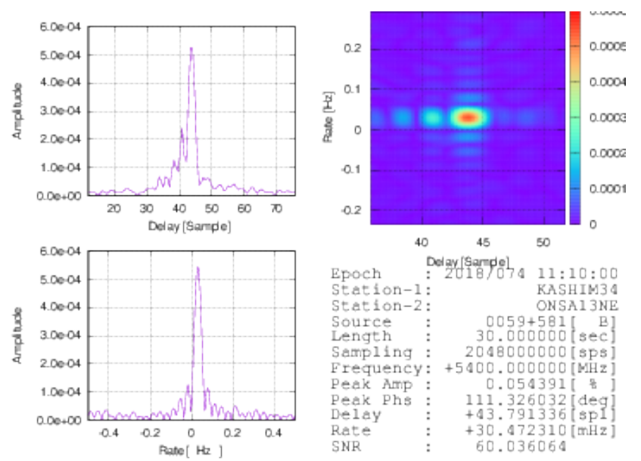
On-Sky Fringe Test: Kashima - Onsala

Slide 30
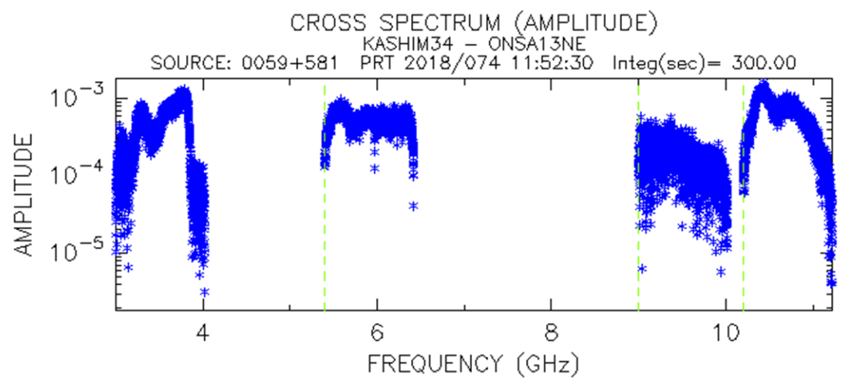
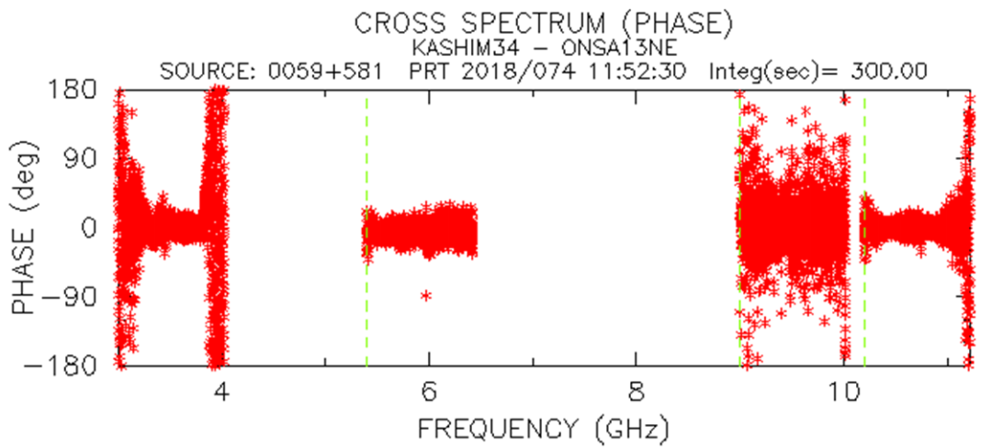
On-Sky Fringe Test: Kashima - Onsala

Slide 31
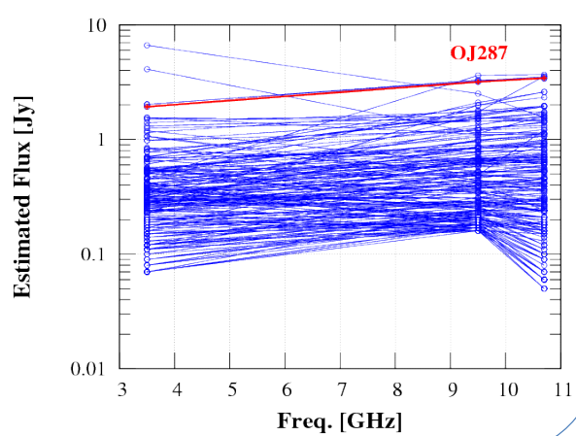
On-Sky Fringe Test: Kashima - Onsala

Slide 32
DBBC History in EHT at APEX
Session History:
2009 Mar Project start VLBI at APEX
2011 Mar Install DBBC2
2011 Mar EHT 2011 campaign (No APEX fringes) 2 Gbps 1x Mark 5C
2012 May First APEX fringes 2 Gbps 1x Mark 5C
2013 Mar EHT 2013 campaign 4 Gbps 2x Mark 5C
2015 Jan First fringes to ALMA (ALMA - APEX)
2015 Jan First fringes to SPT (SPT – APEX)
2015 Mar EHT 2015 campaign 16 Gbps 2x Mark 6
2015 Mar Fringe test 340 GHz (APEX-Pico Veleta, APEX-SMTO)
2015 Jul ALMA phasing commissioning 230 GHz APEX-ALMA-SMA-JCMT
2015 Jul ALMA phasing commissioning 340 GHz APEX-ALMA
2016 July DBBC2 to Bonn for upgrade to DBBC3
2016 Nov Fringe test for PI230 at APEX (2x R2DBE)
2017 Apr Install DBBC3
2017 Apr EHT 2017 campaign (parallel DBBC3 / R2DBE) (32 Gbps 2x Mark 6) x2
2017 Apr Return DBBC3 to Bonn for refinement
2018 Apr EHT 2018 campaign 64 Gbps 4x Mark 6
2018 Sep Now: ready to re-install DBBC3 at APEX and Pico Veleta
2018 Oct EHT 345 GHz Test

