Slide 1
DBBC3 status and deployment
G. Tuccari
Istituto di Radiostronomia, Italy
Max Planck Institute fuer Radioastronomie, Germany

Slide 2
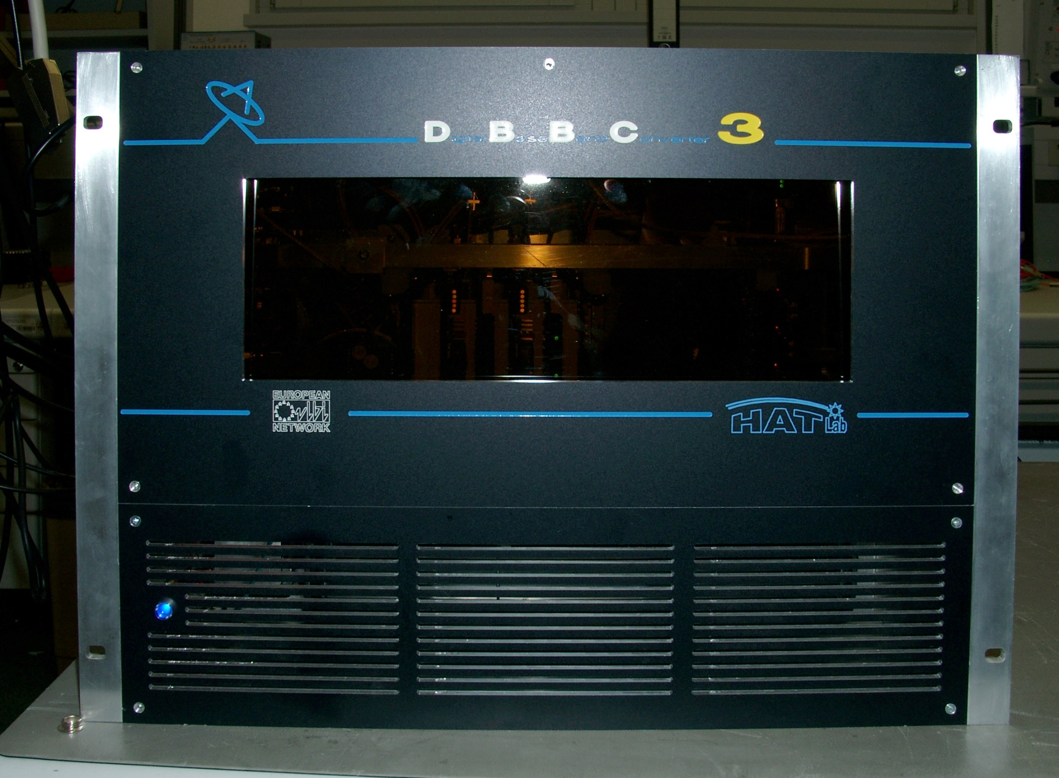

Slide 3
DBBC3L-2L2H Architecture
4 GHz (1st Nyq)
GCOMO
ADB3L
CORE3H
4 GHz in 4 -15 GHz
32 Gbps
4 GHz (1st Nyq)
GCOMO
ADB3L
CORE3H
4 GHz in 4 -15 GHz

Slide 4
DBBC3L-4L4H Architecture
4 GHz (1st Nyq)
GCOMO
ADB3L
CORE3H
4 GHz in 4 -15 GHz
4 GHz (1st Nyq)
GCOMO
ADB3L
CORE3H
4 GHz in 4 -15 GHz
64 Gbps
4 GHz (1st Nyq)
GCOMO
ADB3L
CORE3H
4 GHz in 4 -15 GHz
4 GHz (1st Nyq)
GCOMO
ADB3L
CORE3H
4 GHz in 4 -15 GHz

Slide 5
DBBC3L-8L8H Architecture
4 GHz (1st Nyq)
GCOMO
ADB3L
CORE3H
4 GHz in 4 -15 GHz
4 GHz (1st Nyq)
GCOMO
ADB3L
CORE3H
4 GHz in 4 -15 GHz
4 GHz (1st Nyq)
GCOMO
ADB3L
CORE3H
4 GHz in 4 -15 GHz
4 GHz (1st Nyq)
GCOMO
ADB3L
CORE3H
4 GHz in 4 -15 GHz
128 Gbps
4 GHz (1st Nyq)
GCOMO
ADB3L
CORE3H
4 GHz in 4 -15 GHz
4 GHz (1st Nyq)
GCOMO
ADB3L
CORE3H
4 GHz in 4 -15 GHz
4 GHz (1st Nyq)
GCOMO
ADB3L
CORE3H
4 GHz in 4 -15 GHz
4 GHz (1st Nyq)
GCOMO
ADB3L
CORE3H
4 GHz in 4 -15 GHz

Slide 6
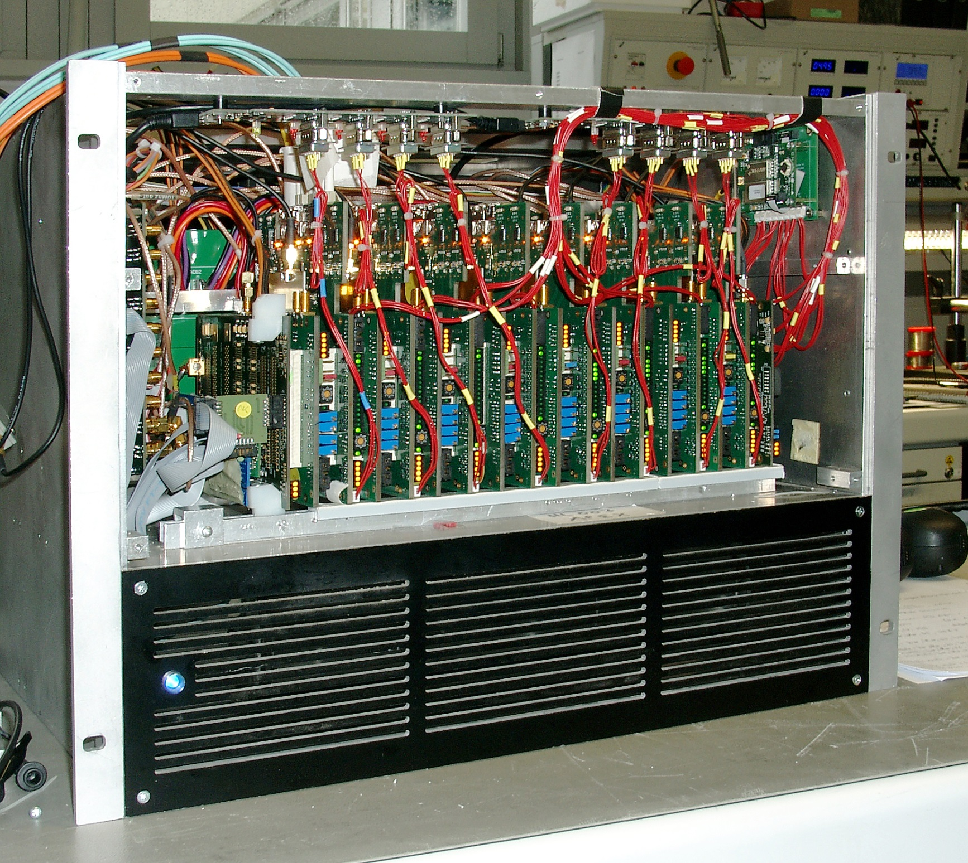
VGOS
DBBC3L-8L8H

Slide 7
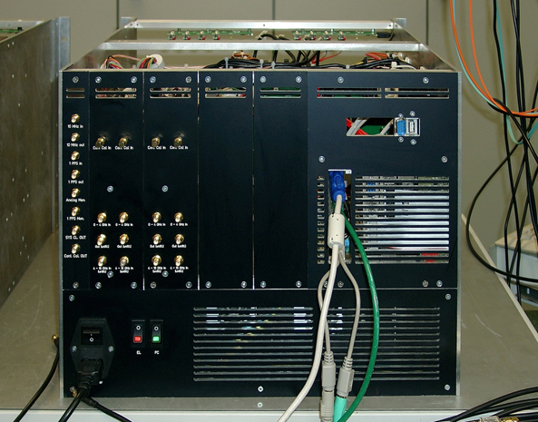
GCoMo

Slide 8
DBBC3L-2L2H Architecture
4 GHz (1st Nyq)
GCOMO
ADB3L
CORE3H
4 GHz in 4 -15 GHz
32 Gbps
4 GHz (1st Nyq)
GCOMO
ADB3L
CORE3H
4 GHz in 4 -15 GHz

Slide 9
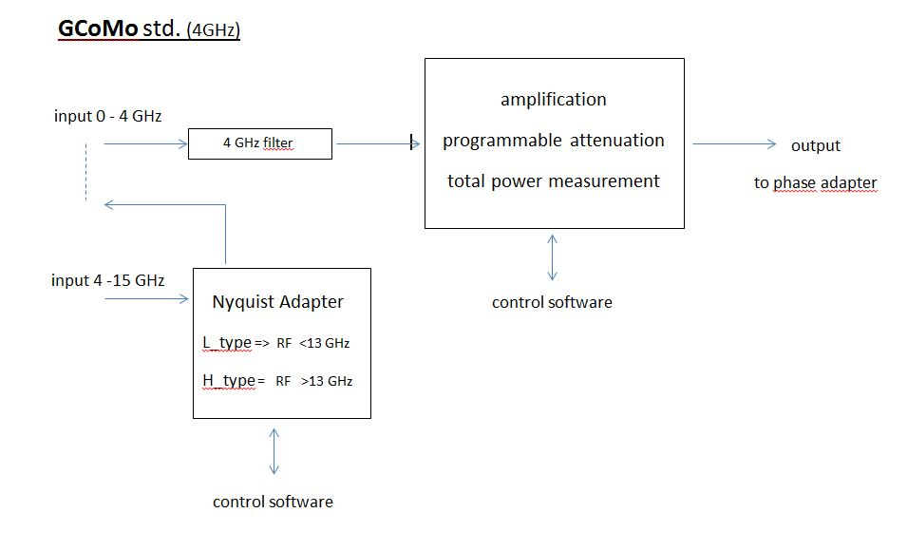

Slide 10
DBBC3L-2L2H Architecture
4 GHz (1st Nyq)
GCOMO
ADB3L
CORE3H
4 GHz in 4 -15 GHz
32 Gbps
4 GHz (1st Nyq)
GCOMO
ADB3L
CORE3H
4 GHz in 4 -15 GHz

Slide 11
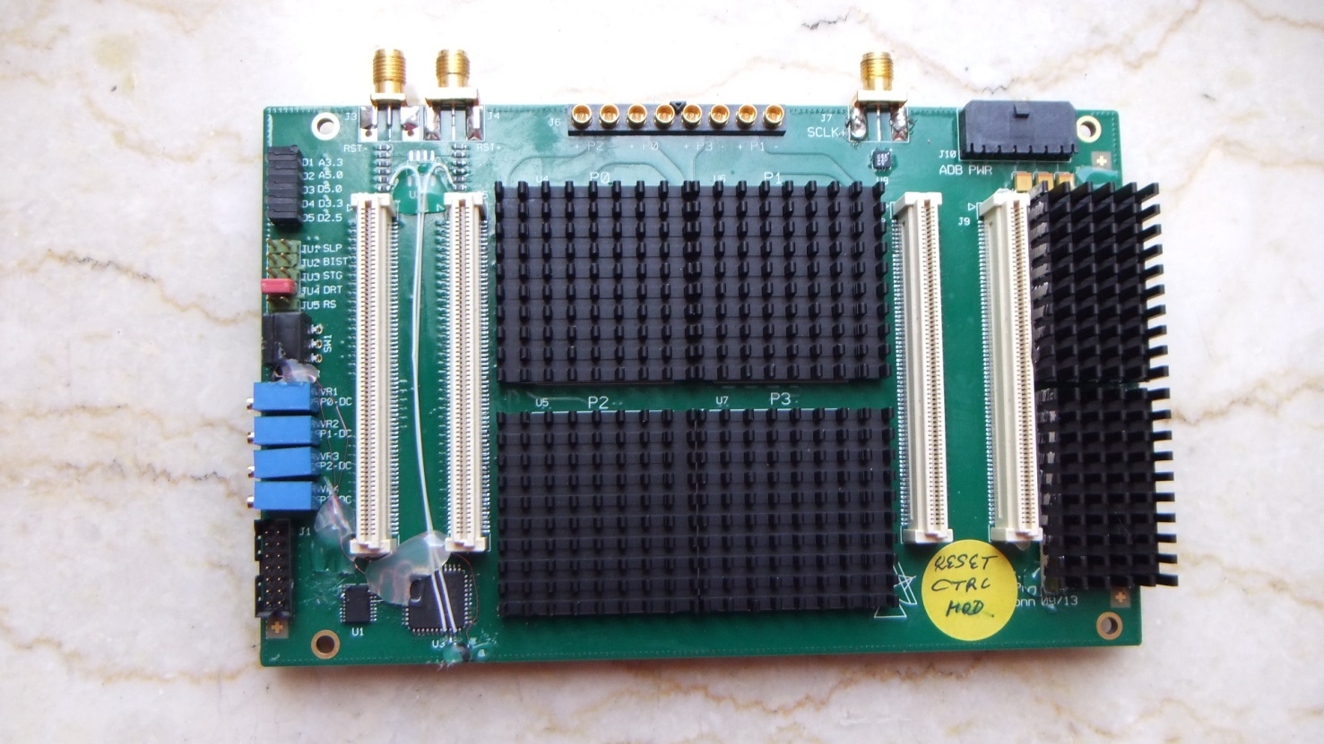
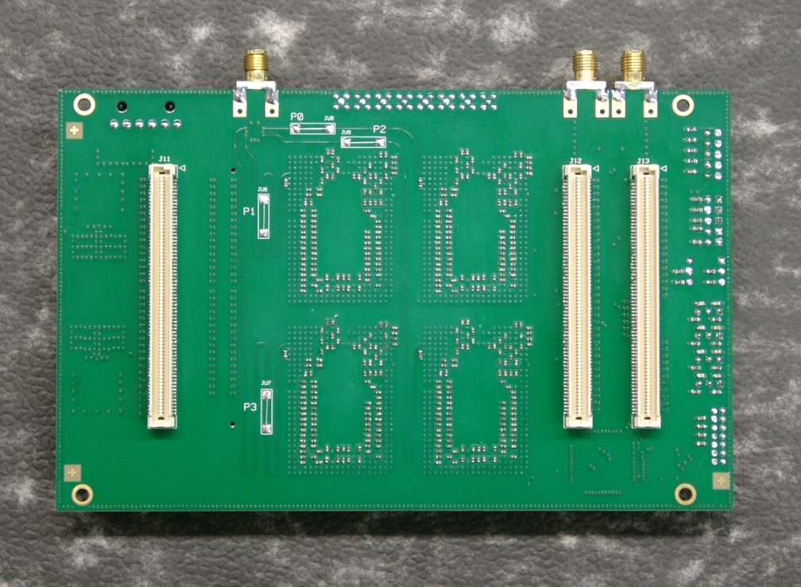
Number of IFs: 1 - 4
Equivalent Sample Rate IF: 8 GSps
Instantaneous bandwidth: 4 GHz
Sampling representation: 10 bit
Real/Complex Sampling
Compatibility with existing DBBC
ADB3L

Slide 12
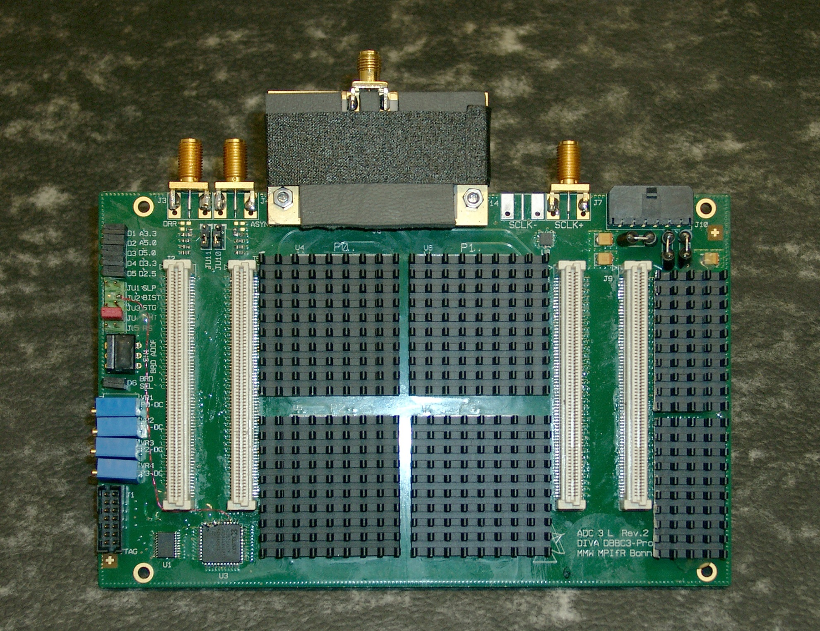
ADB3L and Phase Adapter

Slide 13
DBBC3L-2L2H Architecture
4 GHz (1st Nyq)
GCOMO
ADB3L
CORE3H
4 GHz in 4 -15 GHz
32 Gbps
4 GHz (1st Nyq)
GCOMO
ADB3L
CORE3H
4 GHz in 4 -15 GHz

Slide 14
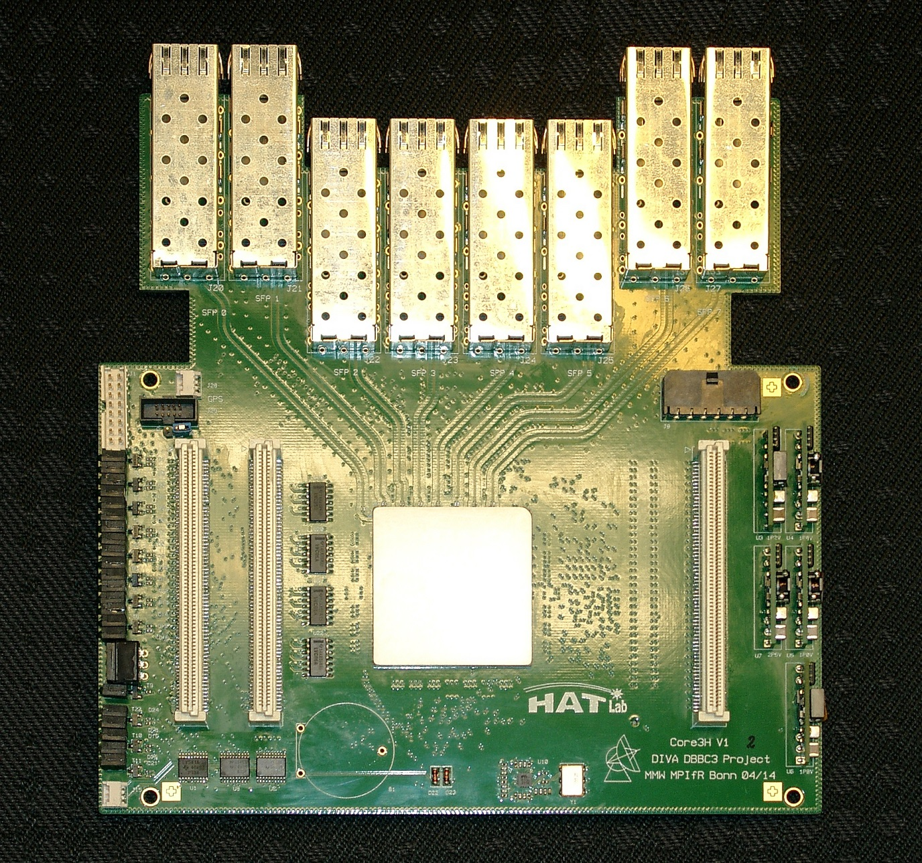
CORE3H
Input bus: HSI & HSI2
Input sampling representation: 8-10 bit
Input bandwidth : 1 x 4GHz, 2 x 2GHz,
4 x 1GHz
Processing capability: DCS, DDC/PFB
Max Output: 8 x 10GE SFP+
Inter-board bus: 8 Input 10GE SFP+
Compatibility with existing DBBC environment

Slide 15
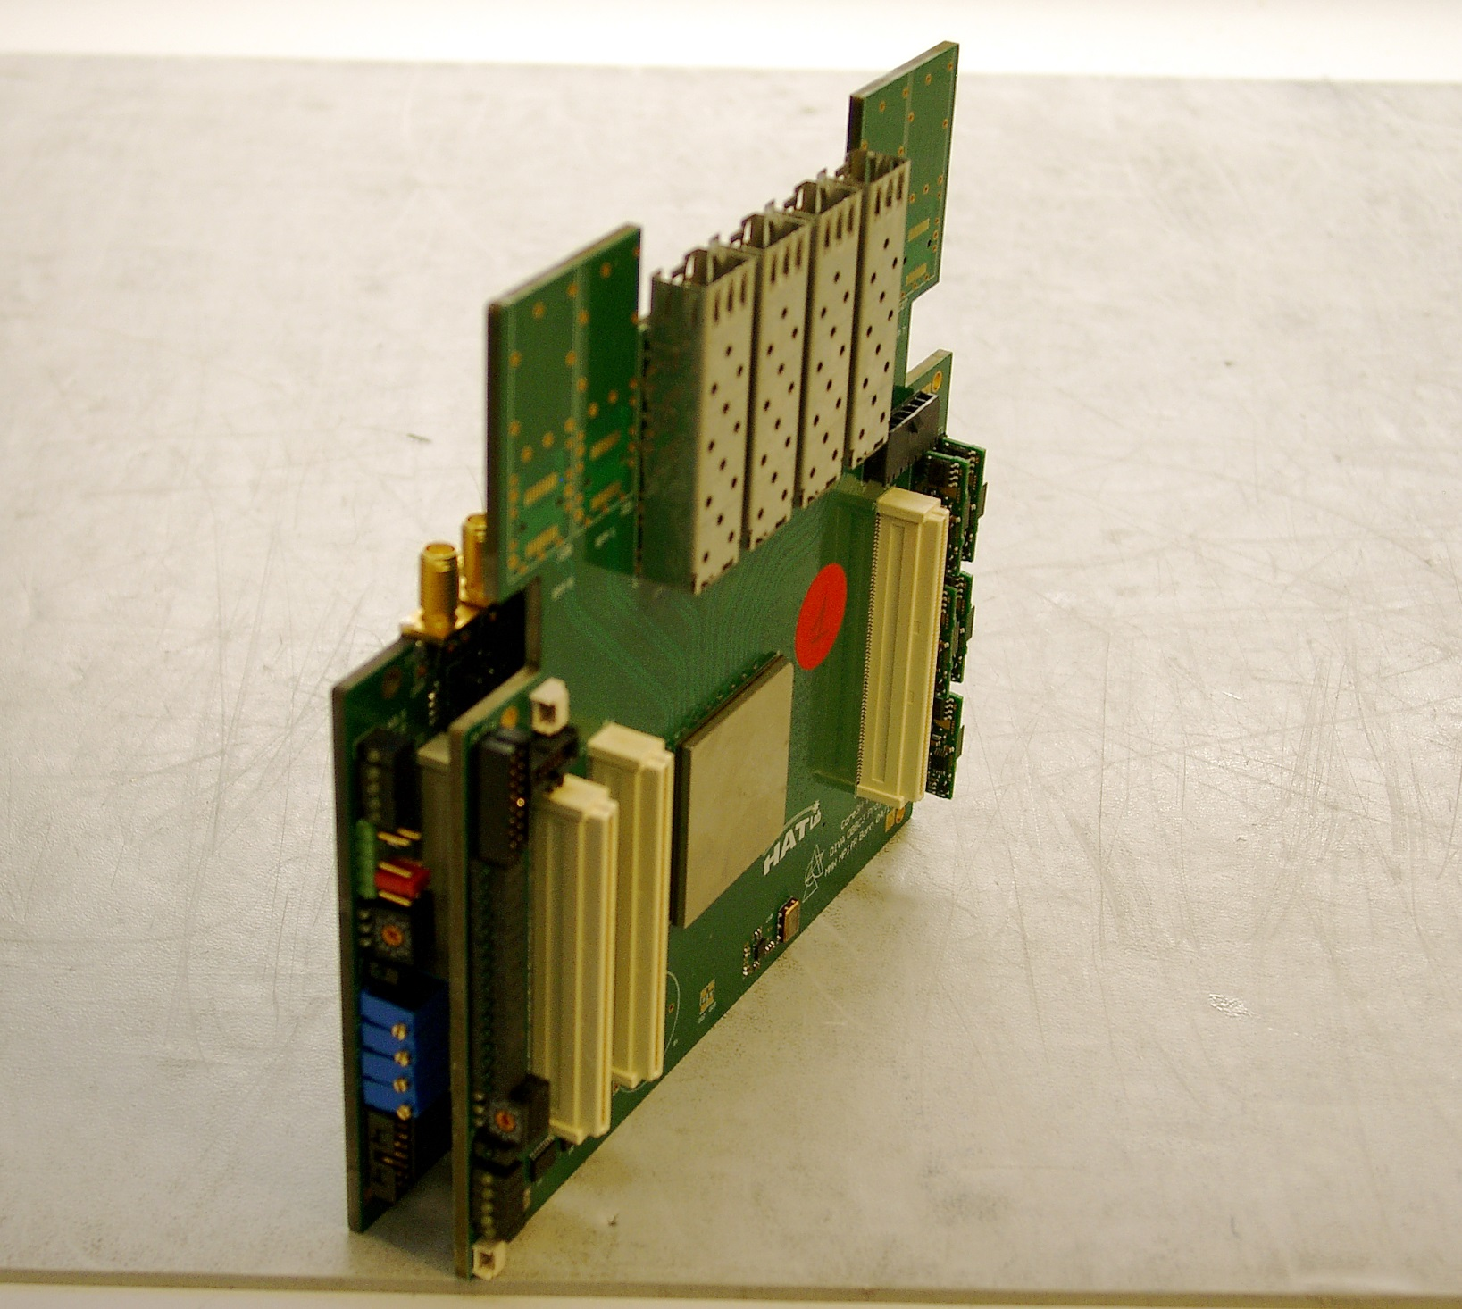
ADB3L +
CORE3H

Slide 16
USB-RS232
GPS
VGOS
DBBC3L-8L8H
GCAT
PCI distribution

Slide 17
DBBC3 Calibration
Necessary for good operations with interleaved sampling without artifacts
Values for delay, offset and gain need to be determined
Needs to be done after assembly of DBBC3 or after any hardware modifications

Slide 18
Control-Software and config-Files
● Control software: DBBC3 Control.exe
● Client: DBBC client v4.exe
● 3 types of config-files
– Main config file: dbbc3_config_file_300.txt
– Sampler settings: config_adb3l.txt
– Core3H settings: dsc_core3H_1.fila10g

Slide 24
DBBC3 Firmware:
Different packages for the modes (.bit, .exe, .txt, .doc)
DSC: 0- 4 GHz —-> operational
OCT1: 0-2, 2-4 GHz —-> operational
0-1, 1-2, 2-3, 3-4 GHz —-> operational
0.5-1.0, 1.0-1.5, ……, 3.5-4.0 GHz —-> operational
OCT2: 2 filters as above at the same time per IF —-> operational
DDC-L: 16 bbc (U&L) 2-4-8-16 MHz tunable in 4GHz —-> operational
(legacy) 32 bands tunable PFB 2-4-8-16 MHz block in 4GHz —-> operational
DDC-V: 12 bbc (U&L) full 32MHz tunable in 4GHz —-> operational
(VGOS) 24 bands 32 MHz PFB block tunable in 4GHz —-> operational
16 bbc (U&L) tunable full 32MHz in 4GHz —-> in progress
32 bands tunable 32 MHz PFB block in 4GHz —-> in progress

Slide 25
DBBC3 New hardware under development:
A new class of samplers to be coupled by optical fibers to the CORE3H
ADB3H1: Double polarizations, 0 - 16 GHz, 8-bit
ADB3H2: Double polarizations, 0 - 24 GHz, 8-bit
ADB3H3: Double polarizations, 0 - 28 GHz, 8-bit

Slide 26
DBBC3 systems delivered and under construction:
APEX, DBBC3-4L4H
PICO VELETA, DBBC3-4L4H
HOBART, DBBC3-6L6H
YEBES, DBBC3-2L2H, GCoMO/CoMo
ONSALA1, DBBC3-8L8H
ONSALA2, DBBC3-8L8H
NyALESUND1, DBBC3-8L8H
NyALESUND2, DBBC3-8L8H
EFFELBERG, DBBC3-2L2H
KOREA (NGII), DBBC3-2L2H
KATHERINE, DBBC3-6L6H
YARRAGDEE, DBBC3-6L6H
WETTZELL, DBBC3-8L8H
SHESHAN, DBBC3-8L8H
METSAHOVI(FGRI), DBBC3-8L8H

